Slide 1
LockedMe.Com
Virtual Key for Repositories
Developed by : Dheeraj Thoke
Cohort : MS FSD DEC 2021 Cohort 1 COURSE 2 Implement OOPS using JAVA with Data Structures and Beyond

Slide 2
Start
Create “files” folder in Project directory
if not present
Switch Input
Value
Case 1
Takes file name to add it to “files” folder
True
Print WELCOME_MESSAGE and call showPrimaryMenu()
Retrieve all files inside “files” folder and display in ascending order and call showPrimaryMenu()
False
Takes file name to delete it from “files” folder
Case 1
True
Switch Input
Value
Case 2
True
Display MAIN_MENU and Take User Input
False
Display Secondary Menu for Performing File Operations and Take User Input
False
Takes file name to search in “files” folder
Case 2
True
Case 3
True
False
False
Case 3
True
Case 4
True
Return to Main menu
False / Wrong Input
Default Statement : Display Message to input correct value and retry
Display Program Terminated Successfully
False / Wrong Input
Default Statement : Display Message to input correct value and retry
End

Slide 3
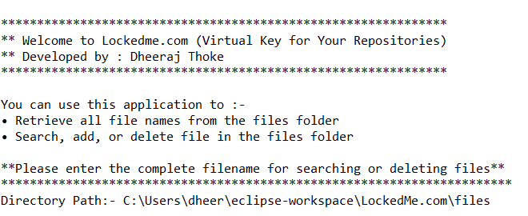

Slide 4
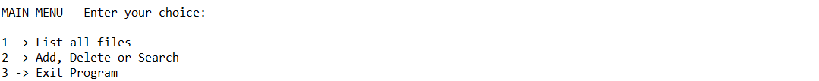

Slide 5
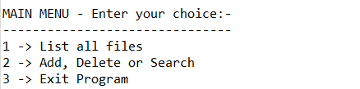

Slide 6
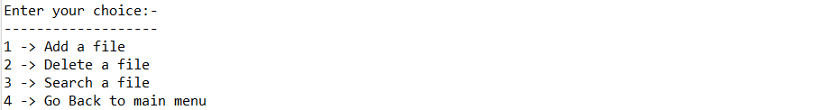

Slide 7
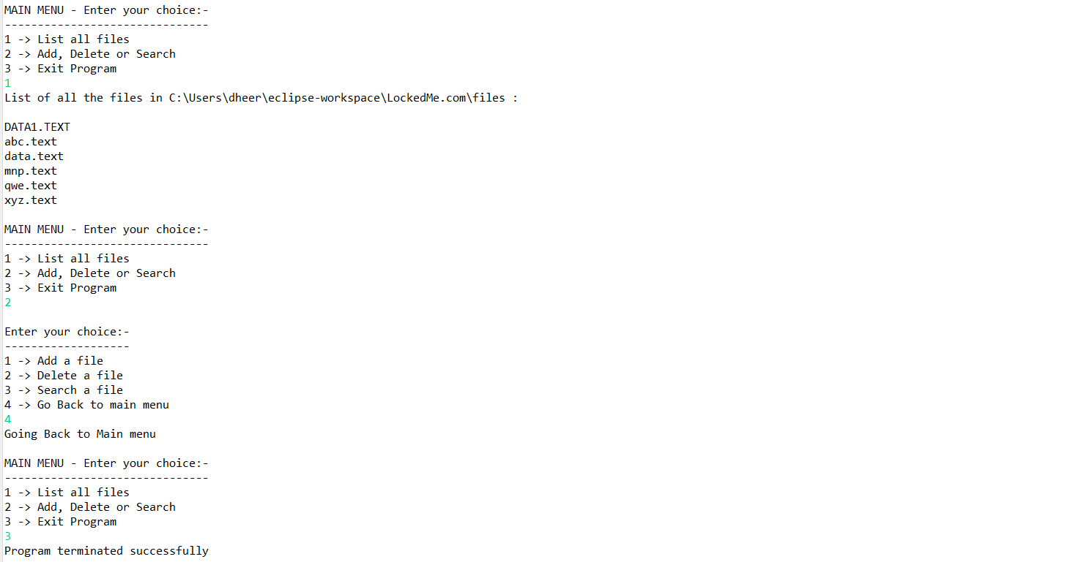

Slide 8
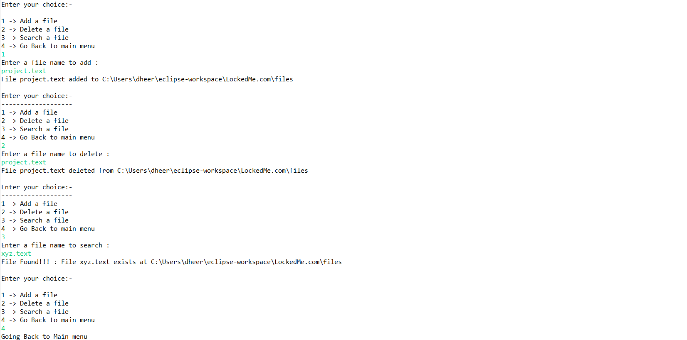

Slide 9
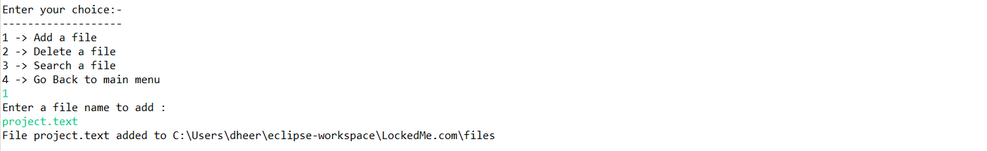

Slide 10
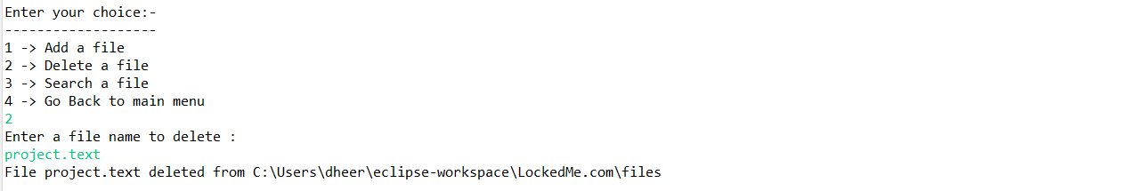

Slide 11
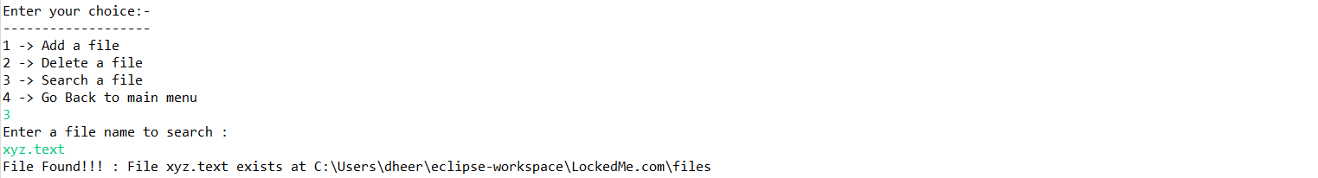

Slide 12
